Slide 1

Vision
Provide full support for all employees who want to embark on this challenge, and world-class education on topics such as entrepreneurial skills and mindset.
Are you Ready?
Goal
Create 1000 Intrapreneurs who grow themselves and challenge through learning and practice
(In-house entrepreneurs)
Launch 10 innovative business to realize Uvance
*in the next three years

Slide 2

FIC 1st Stage of three
Growth
Challenge
Investment and support
to launch new business
Large-Scale investment for business growth Support for commercialization
Academy
Opportunities for business creation
learning through practice
Full-time job for new business creation (6 months)
Mentoring by external experts
Initial investment in developing MVPs
World-class
Entrepreneurship education
Classes by Associate Professor Yasuhiro Yamakawa of Babson College, which is ranked No.1 for entrepreneurship education
Step up to innovators
10 innovative new business
Step up to challenger
1000 employees
Step up to Intrapreneur
300 people
*in the next three years

Slide 3

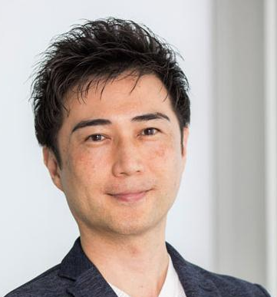
Academy Stage
Step up to challenger
Develop entrepreneurial skill and mind-set, and discover business ideas
Associate Professor of Entrepreneurship,
Babson College Yasuhiro Yamakawa
The World class entrepreneurship education by Dr. Yamakawa of Babson College in lectures, group work practice, and pitch contests to acquire eight essential skills for Intrapreneur.
Social innovation
Creating the future, changing the world via ET&A
Understanding self
Understanding self - vision, mission, and purpose - for life and career
Failure is not bad
Increasing tolerance for failure
Behavioral Styles
Maximizing shared leadership
Creativity
Design thinking for innovation
Art of Pitching
Networking and enrolling others
Analysis
Evaluating opportunity, assessing feasibility, and analyzing stakeholders
Centripetal
Crafting a stronger value proposition towards a mission statement
Rocket Pitch/Final Pitch
Group Work learning through practical training

Slide 4


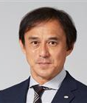
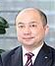
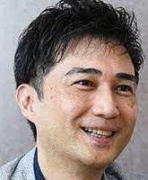
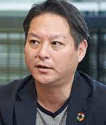
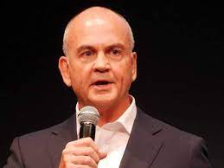

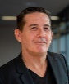
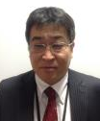
Step up toward Next stage
Let’s try to step up with your entrepreneurship !
If you pass our tryout, you get Challenge stage opportunity
Stage up
Growth
Draft
Investment and support
to launch new business
Stage up
Requirement
Step up to innovator
Challenge
Expect growth in the future
Why Fujitsu should do the Business?
Key Focus Area Business
Tryout
Opportunities for business creation
learning through practice
Requirement
Step up to intrepreneur
Auditor
(KFA Leader/M & A)
Have entrepreneurship enough
Have a strong will to get through
Academy
sustainable
Manufacturing
Consumer
Experience
Healthy Living
Trusted Society
Auditors
Corp. executive
officer Onishi
Corp. executive
officer Yamaguchi
Corp. executive
officer Takahashi
Corp. executive
Officer Hayashi
World-class
Entrepreneurship education
Step up to challenger
program supervision
Associate
Professor
Yamakawa
CDXO Assistant
Corp. executive
Officer
Fukuda
M & A/CVC
Corp. executive
Officer
Nicolas
CVC/Entrepreneur
External
Expert
Digital Shifts
Business
Applications
Hybrid IT
M & A
Corp. executive
Officer Fukuda
Corp. executive
officer White
Corp. executive
officer Koga
Corp. executive
officer Nicolas

